Slide 1
Video
MiC Course Introduction
YouTube Link:

Slide 2
Course Synopsis

Slide 3
Micro-Course Learning Outcomes (MCLO) | At the end of the course, the participants will be able to:

Slide 4
Assessment | Example: You need to complete the assignments in all 3 modules. The details are as follows:
Type of Assessment | Total
Online Quiz | 1
Online Submission | 2
Total Assessment | 3

Slide 5
Facilitators
Team members
1) |  |  | Photo
Affiliation:
E-mail:
2) |  |  | Photo
Affiliation:
E-mail:

Slide 6
Week 1: | Tittle
Learning Outcome:
Learning Material :
Assessment:

Slide 7
Week 2: | Tittle
Learning Outcome:
Learning Material :
Assessment:

Slide 8
Week 3: | Tittle
Learning Outcome:
Learning Material :
Assessment:

Slide 9
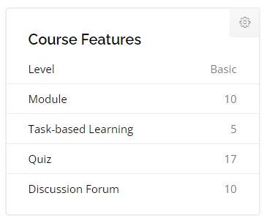
Numbers of Activities in Course
Sample

