Slide 1
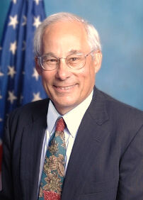
BASIC PRINCIPLES OF HEALTHCARE MANAGEMENT
1a. INTRODUCTION TO MANAGEMENT
PROF. DR ADLINA SULEIMAN
Dept of Business and Healthcare Management
School of Business and Technology
Email: adlinasuleiman@imu.edu.my
“ I think health care is more about love than about most other things.
If there isn’t at the core of these two human beings who have agreed to be in a relationship where one is trying to help relieve the suffering of another, which is love, you can’t get to the right answer here.”
—Donald Berwick, former Administrator of the Centers for Medicare and Medicaid Services

Slide 2
Welcome to IMU, where we nurture your dreams for better healthcare, better humanity.
Content
Definition of management
Essential Managerial Task
Levels and Skills of Manager
Challenges for Management in Global Environment

Slide 3
Learning Outcomes
When you have finished studying this topic, you should be able to explain:
1 TLO 1 | 2 TLO1 | 3 TLO2 | 4 TLO2 | 5 TLO3 | 6 TLO4 | 7 TLO4
Definition of management The importance of studying management Effective vs Efficient management | Difference between management and administration What is an organization? Who are in organizations? Manufacturing vs Service Organizations | Essential managerial functions | The interactions between planning, organizing, leading, and controlling | The roles, levels and skills of managers | Major influences and changes in the 21st century | Challenges of management in the global environment

Slide 4
"The first rule of management is delegation.
Don't try and do everything yourself because you can’t.”
Anthea Turner
WHAT IS MANAGEMENT?
A process of establishing a mission (Planning) for the organization that is appropriate for the competitive environment,
designing a strategy to achieve that mission (Organizing),
then administering (Leading) and
coordinating (Controlling) resources so that the mission will be accomplished in an effective and efficient way.

Slide 5
Why study management?
We all have a vested interest in improving the way organizations are managed.
Better organizations are, in part, the result of good management.
You will eventually either manage or be managed
Gaining an understanding of the management process provides the foundation for developing management skills and insight into the behavior of individuals and the organizations.
Ref: 2004 Prentice Hall, Inc.

Slide 6
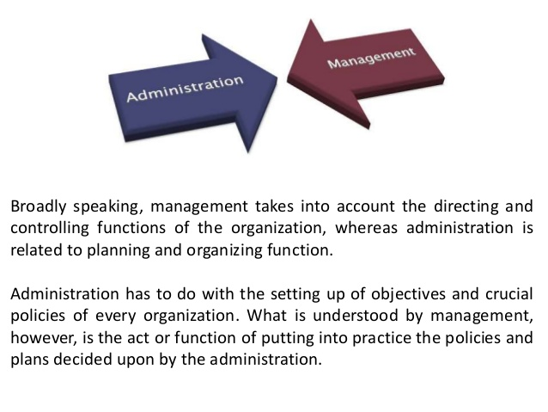
Is there a difference between management and administration?
Ref: https://www.slideshare.net/zulfiquer732/introduction-to-hospital-adminstration

Slide 7
BASIS FOR COMPARISON | MANAGEMENT | ADMINISTRATION
Meaning | An organized way of managing people and things of a business organization is called the Management. | The process of administering an organization by a group of people is known as the Administration.
Authority | Middle and Lower Level | Top level
Role | Executive | Decisive
Concerned with | Policy Implementation | Policy Formulation
Area of operation | It works under administration. | It has full control over the activities of the organization.
Applicable to | Profit making organizations, i.e. business organizations. | Government offices, military, clubs, business enterprises, hospitals, religious and educational organizations.
Decides | Who will do the work? And How will it be done? | What should be done? And When is should be done?
Work | Putting plans and policies into actions. | Formulation of plans, framing policies and setting objectives
Focus on | Managing work | Making best possible allocation of limited resources.
Ref: https://keydifferences.com/difference-between-management-and-administration.html#:~:text=Management

Slide 8
Efficiency is doing things right;
Effectiveness is doing the right things.
Effectiveness versus Efficiency
.
Effectiveness (Goal)
  Achieved when the organization pursues appropriate goals.
  This means “doing the right things”
Efficiency (Resources)
  Achieved by using the fewest inputs (e.g., people and money) to generate a given output.
  This means “doing things right”
The end result of effective and efficient management is organizational success.
You Tube : https://www.youtube.com/watch?v=Brkcj6ie7ic

Slide 9
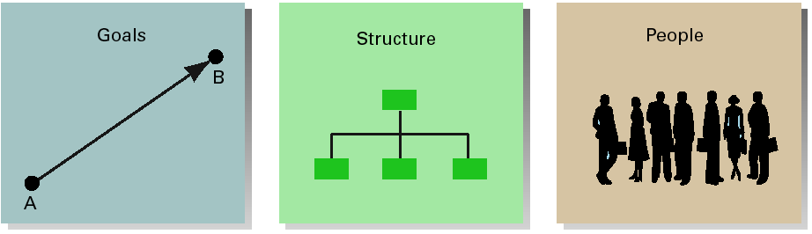
  What is an Organization ?
  A systematic arrangement of people employed together to achieve some specific goal; applies to all organizations—for-profit as well as not-for-profit organizations, government or private.
  A place where managers manage (work)
Common characteristics
Ref: 2004 Prentice Hall, Inc.

Slide 10
Who are in an organization?
Operatives are people who
work directly on a task
have no responsibility for overseeing the work of others
Managers are leaders who
direct the activities of others
Ref: 2004 Prentice Hall, Inc.

Slide 11

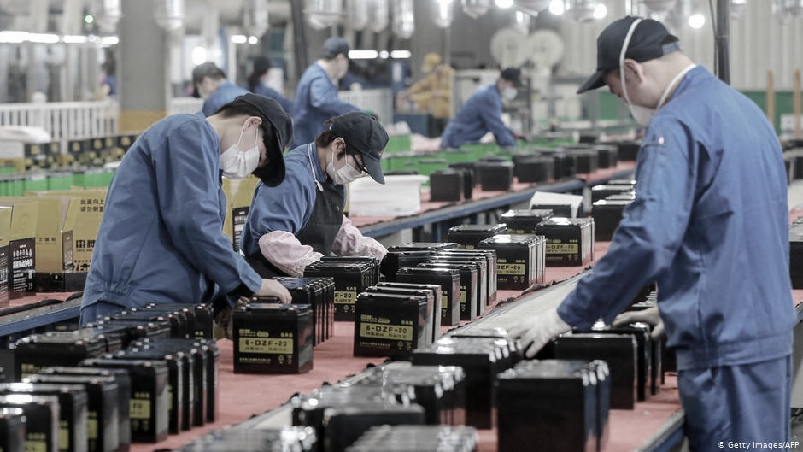
Manufacturers vs Service Organizations
Hospital Services:
Intangible product
Product cannot be inventoried
High customer contact
Short response time
Labor intensive
Factory Manufacturers:
Tangible product
Product is inventoried
Low customer contact
Longer response time
Capital intensive

Slide 12
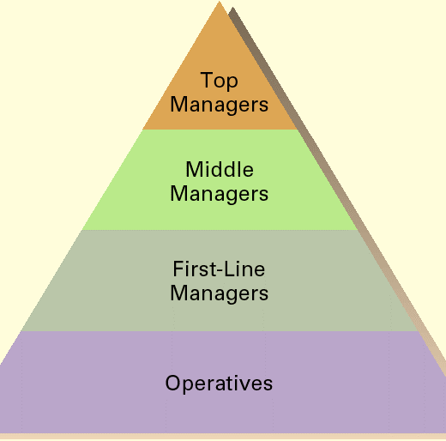
Levels in an Organization
First-line managers
Supervisors - directing the day-to-day activities of operative employees
Middle managers
In between the first-line manager and top management
Top managers
Decision makers - the direction of the organization and establishing policies that affect all organizational members
We will relook at this in the later slides………
Ref: 2004 Prentice Hall, Inc.

Slide 13
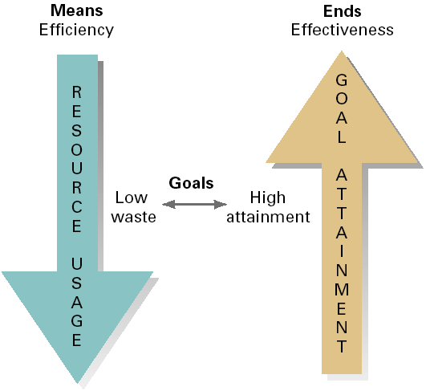
What is Management?
The process of getting things done, effectively and efficiently, through and with other people
Efficiency
doing the thing correctly; refers to the relationship between inputs and outputs; seeks to minimize resource costs
Effectiveness
doing the right things; goal attainment
Management is the coordination of all resources through the process of planning, organizing, directing and controlling in order to attain stated goals."
Ref: 2004 Prentice Hall, Inc.

Slide 14
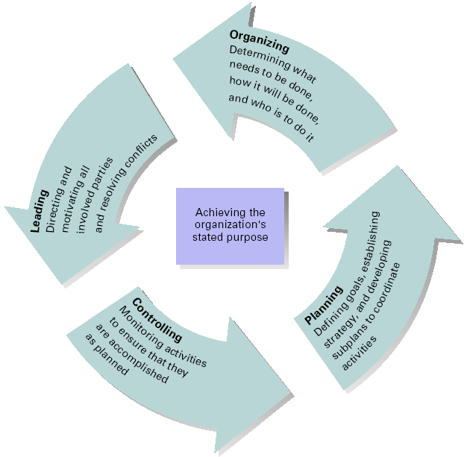
What is the Management process (activities): planning, organizing, leading, and controlling
Ref: 2004 Prentice Hall, Inc.

Slide 15
Management Process Activities
Planning
Includes defining goals, establishing strategy, and developing plans to coordinate activities
Organizing
Includes determining what tasks to be done, who is to do them,
how the tasks are to be grouped, who reports to
whom, and where decisions are to be made
Leading
Includes motivating employees, directing the activities of others, selecting the most effective communication channel, and resolving conflicts
Controlling
The process of monitoring performance,
comparing it with goals, and
correcting any significant
deviations
Ref:2004 Prentice Hall, Inc.

Slide 16
Latest: Five functions of great management
1. Planning: process of choosing appropriate goals and actions to pursue then
determining what strategies to use, what actions to take, and deciding what resources are needed to achieve the goals.
2. Organizing: process of establishing worker relationships, allows workers to work together to achieve their organizational goals.
3. Leading: involves articulating a vision, energizing employees, inspiring and motivating people using vision, influence, persuasion and effective communication skills.
4. Staffing: Recruiting and selecting employees for positions within the company (within teams and departments).
5. Controlling: Evaluate how well you are achieving your goals, improving performance, taking actions.
Implement processes in place to help establish standards, to enable measurement, comparison and assist in decision making.
Ref:https://www.uagc.edu/blog/5-principles-of-great-management#:~:text=At%20the%20most%20fundamental%20level,to%20be%20a%20successful%20manager.

Slide 17
1. Planning: process of choosing appropriate goals and actions to pursue then
determining what strategies to use, what actions to take, and deciding what resources are needed to achieve the goals.
2. Organizing: process of establishing worker relationships, allows workers to work together to achieve their organizational goals.
3. Leading: involves articulating a vision, energizing employees, inspiring and motivating people using vision, influence, persuasion and effective communication skills.
4. Staffing: Recruiting and selecting employees for positions within the company (within teams and departments).
5. Controlling: Evaluate how well you are achieving your goals, improving performance, taking actions.
Implement processes in place to help establish standards, to enable measurement, comparison and assist in decision making.
Ref:https://www.uagc.edu/blog/5-principles-of-great-management#:~:text=At%20the%20most%20fundamental%20level,to%20be%20a%20successful%20manager.

Slide 18
What is the Manager’s Roles:
Mintzberg’s Managerial Roles
Decisional
  Entrepreneur
  Disturbance hander
  Resource allocator
  Negotiator
Interpersonal
  Figurehead
  Leader
  Liaison
Informational
  Monitor
  Disseminator
  Spokesperson
Which is most important?
Copyright © 2004 Prentice Hall, Inc.

Slide 19
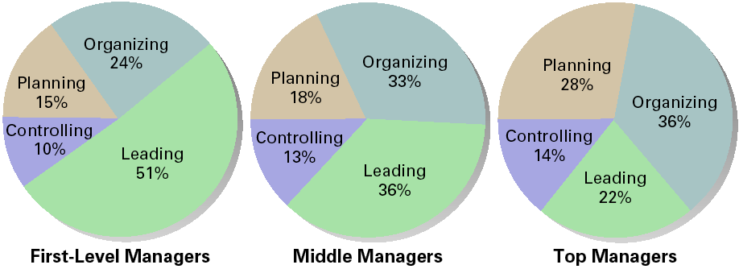
Different managerial level, different task
Level in the organization
  Do managers manage differently based on where they are in the organization?
Profit versus not-for-profit
  Is managing in a commercial enterprise different than managing in a non-commercial organization?
Size of organization
  Does the size of an organization affect how managers function in the organization?
Management concepts and national borders
  Is management the same in all economic, cultural, social and political systems?
Where are you?
Copyright © 2004 Prentice Hall, Inc.

Slide 20
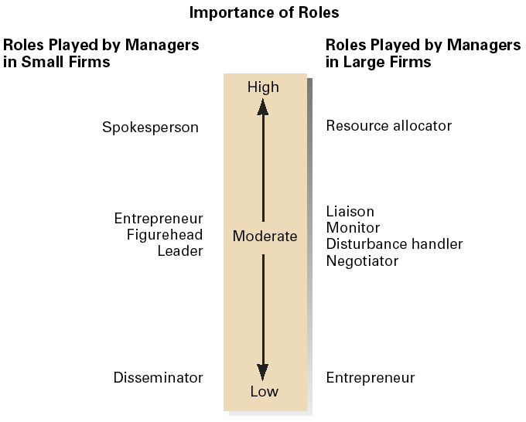
Different Managerial Roles depending on Business Size
Copyright © 2004 Prentice Hall, Inc.

Slide 21
Competencies for Middle Managers
Initiate and implement change and improvement in services, products, and systems
Monitor maintain, and improve service and product delivery
Monitor and control the use of resources
Secure effective resource allocation for activities and projects
Recruit and select personnel
Develop teams, individuals, and self to enhance performance
Plan, allocate, and evaluate work carried out by teams, individuals and self
Create, maintain, and enhance effective working relationships
Seek, evaluate, and organize information for action
Exchange information to solve problems and make decisions
Copyright © 2004 Prentice Hall, Inc.

Slide 22
Key Challenges and Emerging Trends
A set of challenges and emerging trends were identified across healthcare sectors internationally - grouped at three levels:
macro, system context (society, demography, technology, political economy, legal framework, history, culture),
meso, organisational context (infrastructure, resources, governance, clinical processes, management processes, suppliers, patients),
3) micro context related to the individual healthcare manager
Interplay between different factors across different levels, and their direct and indirect reciprocal influences on healthcare management policies and practices
https://bmchealthservres.biomedcentral.com/articles/10.1186/s12913-019-4080-7

Slide 23
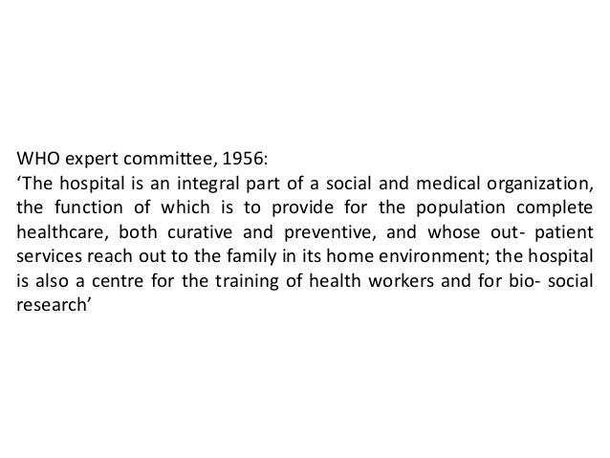

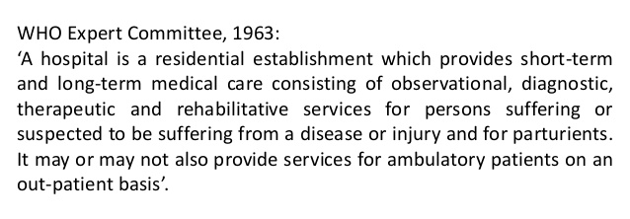
Key Challenges and Emerging Trends

Slide 24
Components and Functions of a Hospital
Medical care ‐ which involves the treatment and management of patients through the staff of physicians.
Patient Support ‐ which relates directly to patient care and includes nursing, dietary diagnostic, therapy, pharmacy and laboratory services.
Administrative ‐ which concerns the execution of policies and directions of the hospital governing discharge of support services in the area of finance, personnel, materials and property, housekeeping, laundry, security, transport, engineering and board and other maintenance
Teaching ‐ Vocational, Undergraduate, Postgraduate, Continuing education.
Research ‐ Basic research, Clinical research, Health services research, Educational research.
Employment ‐ Inside hospital : Health professionals, other health care workers
Outside hospital: Suppliers, Transport services.
Ref: https://www.brainkart.com/article/Functions-of-hospitals_23491/

Slide 25
Hospitals:
Major responsibilities under administrative services
1. To plan, direct and coordinate financial operations of the hospital.
2. To prepare work and financial plan and provide fund estimates for programs and projects.
3. To manage the receipt and disbursement of cash/ collections.
4. To administer personnel development programs, policies and standards;
5. To give advice on matters affecting policies, enforcement and administration of laws, rules and regulations.
6. To procure, store, manage and issue the inventory and disposal of unserviceable hospital equipment and materials
7. To provide general services such as repairs and maintenance, housekeeping, laundry, transport and security.
Ref: https://www.brainkart.com/article/Functions-of-hospitals_23491/

Slide 26
Critical points regarding functions of hospitals
1. Health care services are delivered by people to people within various social environments, which can influence the way medical technology is delivered or received and the clinical outcomes for people seeking help.
2. The rising costs and inconsistent quality of health care have raised significant questions among professionals, policy makers, and the public about the way health services are being delivered.
Ref: https://www.brainkart.com/article/Functions-of-hospitals_23491/

Slide 27
Critical points regarding functions of hospitals
Three central issues in the sociology of health services to be looked at:
a. Health services unequally distributed, contributing to health inequalities across status groups;
b. Social institutions reproduce health care inequalities by constraining and enabling the actions of health service organizations, health care providers, and consumers;
c. The structure and dynamics of health care organizations shape the quality, effectiveness, and outcomes of health services for different groups and communities;
All influence policy implications for future health care reform efforts.

Slide 28
The Private Wing Story
You are asked to set up the private medical centre wing for your government hospital. You have been given 4 months to set it up and get it running. The administration has no idea how to do this. You are given:
An initial budget of RM 500,000
The 2 empty wards on the 8th floor of the east wing of your hospital capacity of 15 patients on ward A and 20 patients on ward B.
You can hire two initial staff to help you and use 2 other staff from your current hospital.
You must decide how and where to set up the clinic that feeds into this centre.
You must decide how to blend the private services with the public one including rental options and when and how to switch services.
You are to look into registration, supply chain issues, financial accounting system issues, governance, patient safety and quality assurance issues.

Slide 29
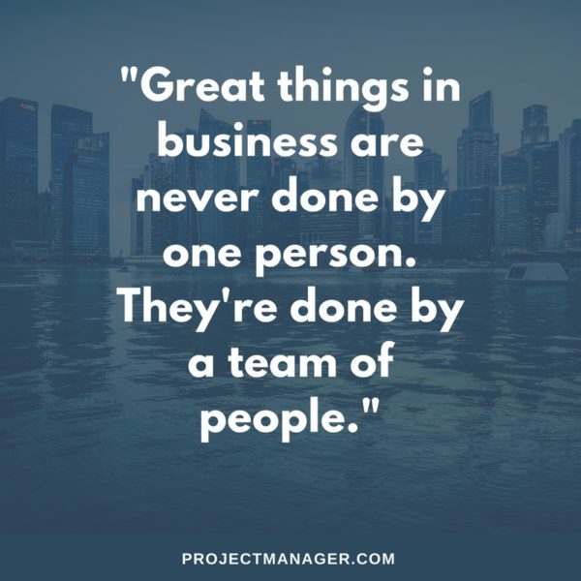
Break time and Break out discussion: 30 mins
Why?
Who?
How?
What?
Where?
When?
First - Pick your management team :prioritize your management issues and assign people to it :
Financial (the money man-must have qualifications and be street smart, must know the game and the game-players?), Marketing, Operational Management, Human Resource, Engineering and maintenance, Information Technology, Hospitality Management
Second: Clinic set-up - ? Ward set-up -?Pharmacy set-up -?
Third:Liaison person govt to private? Marketing ops liase companies, insurance, -?

Slide 30
A lesson from Patch Adams
https://www.youtube.com/watch?v=KDEjgOFOLho

Slide 31
Preparation for tutorial
Management in the global environment faces several key challenges:
Cultural Differences:
Regulatory and Legal Differences:
Global Supply Chain Management: Managing logistics, sourcing, and distribution across different regions requires overcoming challenges like varying tariffs, customs, and geopolitical risks.
Technology and Infrastructure Disparities:
Currency and Economic Instability: Exchange rate fluctuations and economic volatility in different regions can impact profitability and financial planning.
Political and Social Instability: Talent Management:

Slide 32
Definition of
Health
Health is a state of complete physical, mental and social well being and not merely the absence of disease or infirmity (WHO 1948)
Dimensions of health
  Physical
  Mental
  Social dimension
  Spiritual
  Emotional
  Vocational
Philosophy of health
Fundamental human right
Health is intersectoral
Integral part of development
Central to the concept of quality of life
It is essence of productive life,
Health involves individual, state and international responsibility.
Health is world wide social goal

Slide 33
What is disease?
Webster Dictionary
A condition in which body health is impaired, departure from a state of health, an alteration of human body interrupting the performance of vital function.
Oxford Dictionary
A condition of the body in which its functions are disrupted or deranged.

Slide 34
Determinants of
Health
Biological determinants
Behavioral and socio- cultural
Environment
Socioeconomic
Health Services
Ageing and Population
Gender
Other factors

Slide 35
Natural History of Disease
Period of pre-pathogenesis
Period of pathogenesis
Disease process
Before man is involved
Course of disease in man
Death
Agent
Chronic state
Spectrum
of disease
Disability
Illness
Signs &symptoms
Host
Environment
Sub- clinical
Levels
of prevention
Secondary
prevention
Tertiary prevention
Primary prevention
Modes Of intervention
Health promotion
Specific protection
Early diagnosis
& treatment
Disability
limitation
Rehab

Slide 36
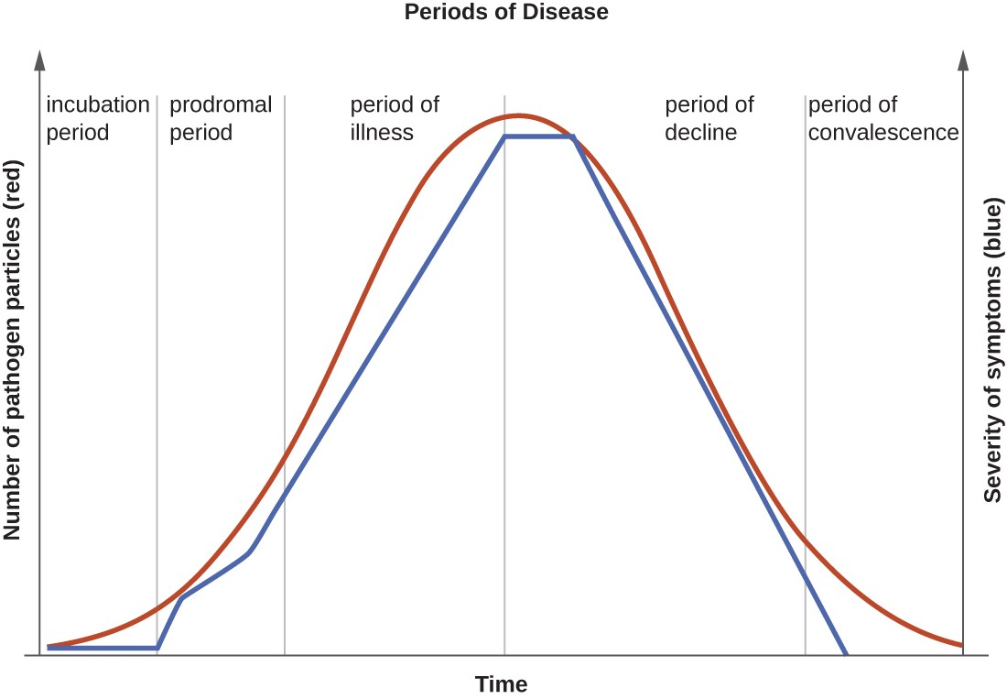
The progression of an infectious disease can be divided into five periods, which are related to the number of pathogen particles (red) and the severity of signs and symptoms (blue).

Slide 37
Iceberg Phenomena
This concept is closely related to spectrum of disease.
The floating tip of the iceberg is what the physicians sees in the community and seek treatment (clinical cases)
The vast submerged portion of the iceberg represents the hidden mass of disease. (latent, inapparent, presymptomatic, undiagnosed cases, carriers ) which the physician does not see
A larger number of people did not seek treatment compared to the ‘tip’ of the iceberg–those who seek treatment
The Clinical Iceberg
PATIENTS WITH ASYMPTOMATI
DISEASE
Seek Treatment
Do not seek treatment

Slide 38
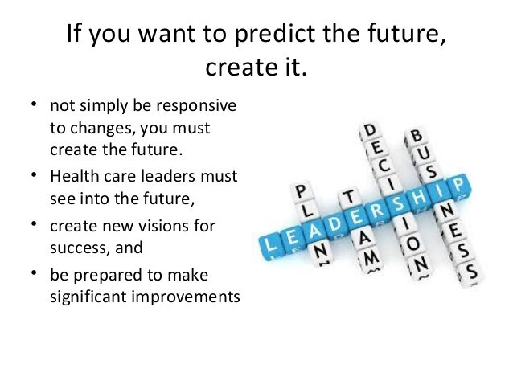

THANK YOU
ANY QUESTIONS?
https://www.slideshare.net/MBA-ASAP/strategic-management-of-healthcare-organizations

